Slide 1

E-Retail Factors
For
Customer Retention:
Case Study from Indian E-Commerce Customers

Slide 2
Problem Statement
Customer satisfaction has emerged as one of the most important factors that guarantee the success of online store; it has been posited as a key stimulant of purchase, repurchase intentions and customer loyalty. A comprehensive review of the literature, theories and models have been carried out to propose the models for customer activation and customer retention. Five major factors that contributed to the success of an e-commerce store have been identified as: service quality, system quality, information quality, trust and net benefit. The research furthermore investigated the factors that influence the online customers repeat purchase intention. The combination of both utilitarian value and hedonistic values are needed to affect the repeat purchase intention (loyalty) positively. The data is collected from the Indian online shoppers. Results indicate the e-retail success factors, which are very much critical for customer satisfaction.
Apply analytical skills to give findings and conclusions in detailed data analysis.

Slide 3
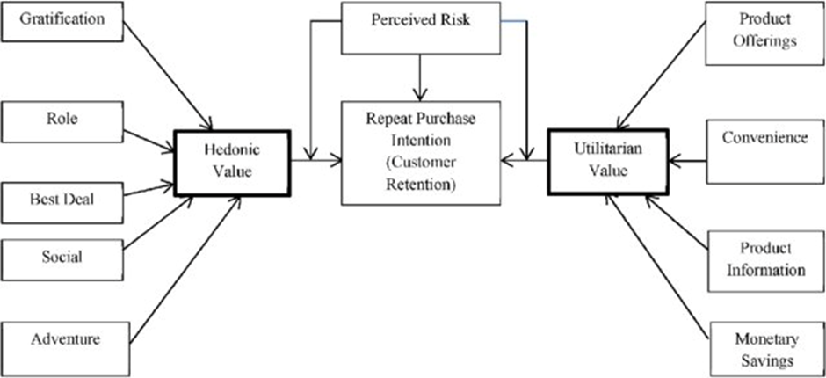
Repeat Purchase Intention (Customer Retention)

Slide 4
What is Customer retention ?
Customer retention refers to the activities and actions companies and organizations take to reduce the number of customer defections. The goal of customer retention programs is to help companies retain as many customers as possible, often through customer loyalty and brand loyalty initiatives. It is important to remember that customer retention begins with the first contact a customer has with a company and continues throughout the entire lifetime of the relationship.
Customer retention is a business’s ability to keep existing customers and continue to generate revenue from them. Companies use different tactics to convert first-time buyers into repeat shoppers. In other words, customer retention allows a business to increase the profitability of an existing customer and maximize their lifetime value (LTV).

Slide 5
Why Customer retention is important ?
Customer retention is vital in driving repeat purchases and ongoing value from your customer base. One oft-cited rule of thumb is that it costs five times as much to acquire a new customer as it does to retain an existing customer. Two of the most important factors in improving customer retention is understanding your customers’ satisfaction and loyalty. Businesses also need to understand any operations that may turn off potential and existing customers, such as slow or poor customer service or a faulty product.

Slide 6
About Dataset
There are 269 rows and 71 columns in the dataset.
There are 70 columns which are of object type.
There is 01 column which is of int type.
There is no null values in the dataset.
All column contain n-unique values.
Except one column which is “How do you access the internet while shopping on-line?” has 4 type of values Mobile internet, Wi-Fi, Mobile Internet, Dial-up. Mobile internet and Mobile Internet are of same type. So, I am combining Mobile internet with Mobile Internet.

Slide 7
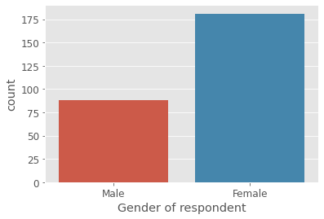
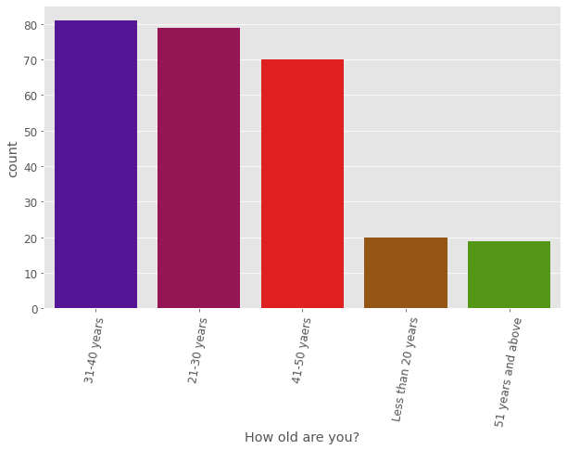
Exploratory Data Analysis
181 of the respondent are Female and 81 are Male.
So , the Female are in majority.
81 are from age group 31-40 years, 79 from 21-30 years and 70 from 41-50 years.
So, majority are from 21-50 years.

Slide 8
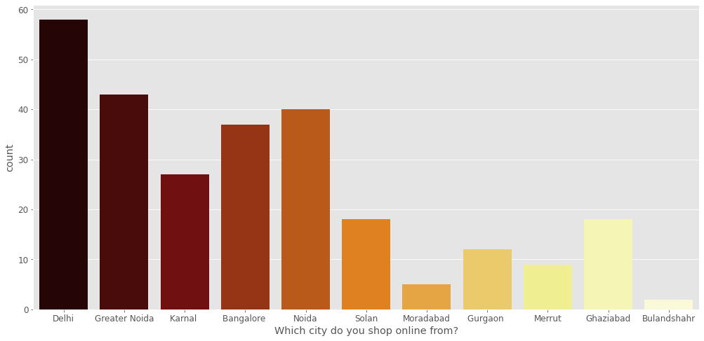
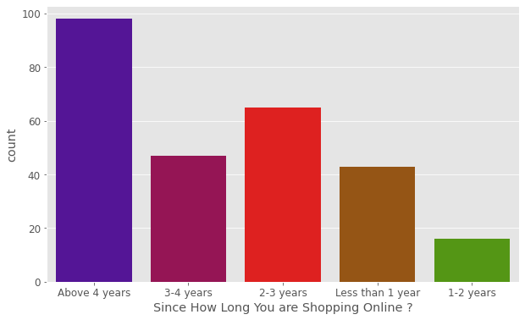
58 from Delhi, 43 from Greater Noida, 40 from Noida.
So, majority are from Delhi city.
98 are those who shopping online above 4 years, 65 are those who shopping online 2-3 years.
So, majority of those who are shopping online above 4 years.

Slide 9
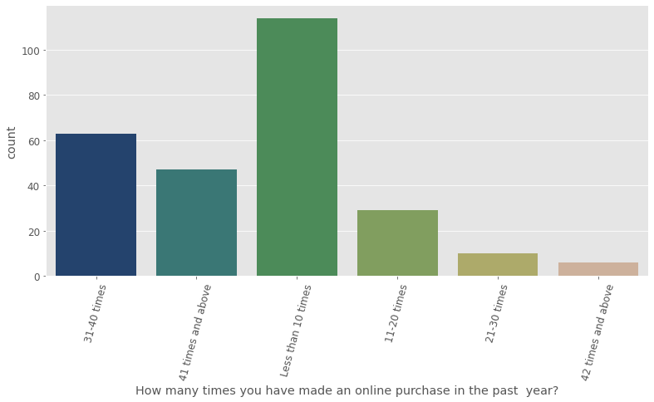
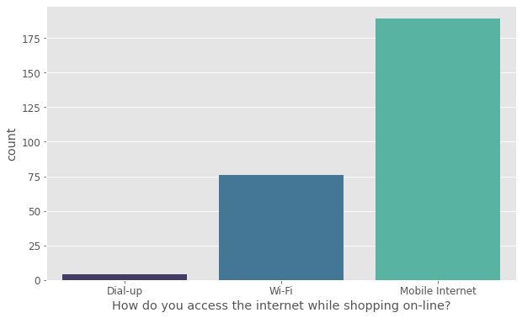
114 are those who made less than 10 times an online purchase in the past year and 63 are those who made 31-40 times an online purchase in the past year.
So, those who purchase less than 10 times in the past year are in majority.
While shopping online 189 are access the internet via Mobile Internet, 76 via Wi-Fi, 4 via Dial-up.
So, majority of those who are accessing internet via Mobile Internet.

Slide 10
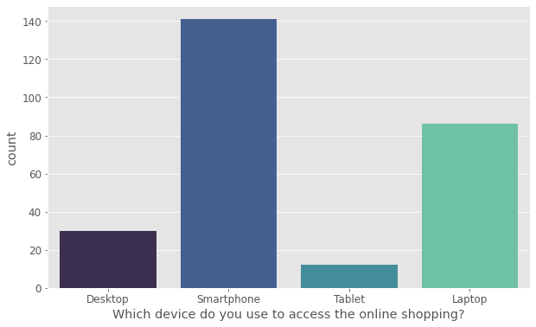
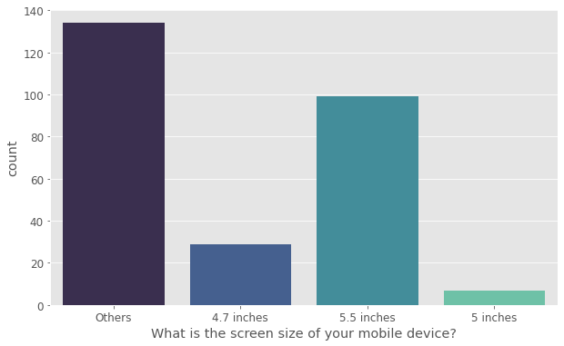
141 are using Smartphone, 86 Laptop, 30 Desktop and 12 Tablet.
So, majority of those who are using Smartphone to access the online shopping.
The screen size of mobile device of 29 customer is 4.7 inch, 7 customer is 5 inch, 99 customer is 5.5 inch and 134 is other size.
So, the majority are of other screen size of mobile device.

Slide 11
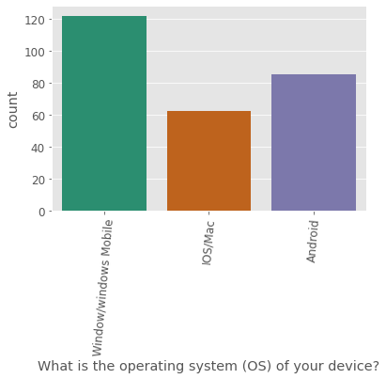
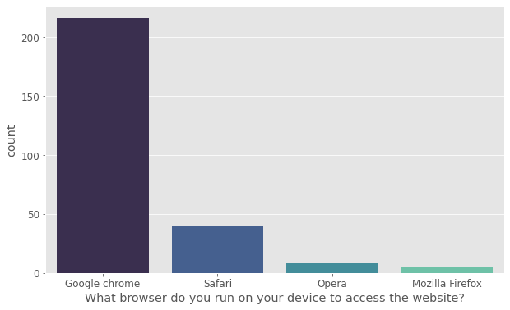
122 are using Window/windows Mobile, 85 Android, 62 IOS/Mac.
So, majority are of Window / windows Mobile users.
216 are using Google chrome browser to access the website, 40 use Safari, 8 use Opera, 5 use Mozilla Firebox.
So, majority are of those who run Google chrome as browser to access the website.

Slide 12
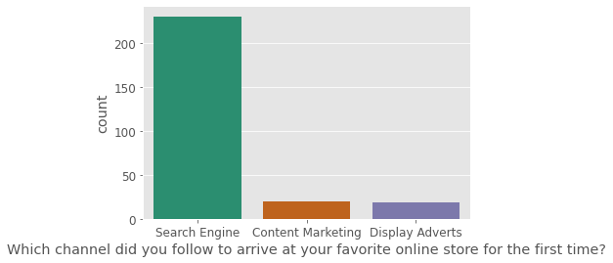
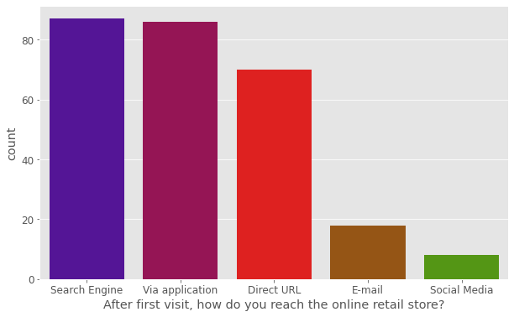
230 are follow Search Engine, 20 are follow Content Marketing, 19 are follow Display Adverts to arrive first time at favorite online store.
So, majority are of those who arrive via Search Engine.
87 via Search Engine, 86 via application, 70 via Direct URL, 18 via E-mail, 8 via Social Media reach the online retail store after first visit.
So, majority are of those who arrive via Search Engine.

Slide 13
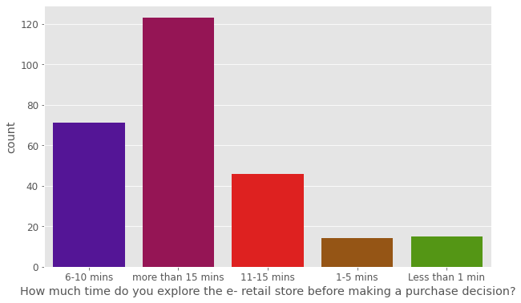
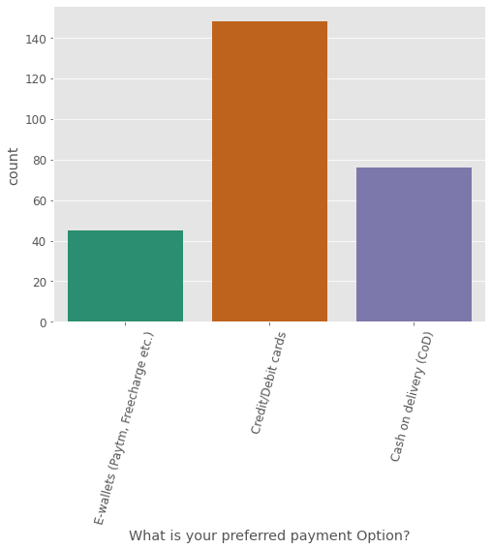
123 took more than 15 mins, 71 6-10 mins, 46 11-15 mins, 15 less than 1 min, 14 1-5 mins explore the e-retail store before making a purchase decision.
So, majority are of those who took more than 15 mins.
148 preferred Credit/Debit cards, 76 Cash on delivery, 45 E-wallets as payment Option.
So, majority are of those who preferred Credit/Debit cards.

Slide 14
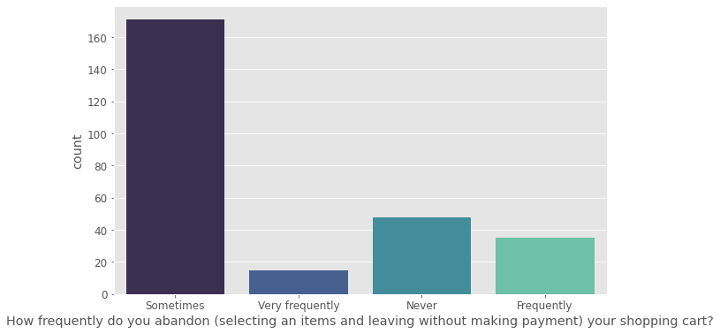
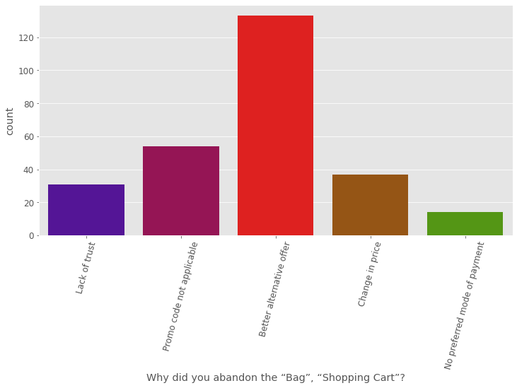
171 Sometimes, 48 Never, 35 Frequently and 15 Very frequently are the counts of those abandon the shopping cart.
So, majority are of those who don’t do it.
133 for Better alternative offer, 54 for Promo code not applicable, 37 for Change in price, 31 for Lack of trust and 14 No preferred mode of payment abandon the “Bag”, “Shopping Cart”.
So, majority are for Better alternative offer.

Slide 15
Points of survey on which customers are Strongly agree:
The content on the website must be easy to read and understand.
Loading and processing speed.
Online retail store will fulfil its part of the transaction at the stipulated time.
Responsiveness, availability of several communication channels.
Shopping online is convenient and flexible.
Comparison of highlighted product with similar product.
Website must have User friendly Interface.
Empathy (readiness to assist with queries) towards the customers.
Online shopping gives monetary benefit and discounts.
Return and replacement policy of the e-tailer is important for purchase decision.
Ease of navigation in website.
Convenient Payment methods.
Being able to guarantee the privacy of the customer.
Enjoyment is derived from shopping online.
Gaining access to loyalty programs is a benefit of shopping online.

Slide 16
Points of survey on which customers are Strongly agree:
Displaying quality Information on the website improves satisfaction of customers.
User satisfaction cannot exist without trust.
Monetary savings.
Satisfaction while shopping on a good quality website or application.
E-commerce Offering a wide variety of listed product in several category.
All relevant information on listed products must be stated clearly.
Net Benefit derived from shopping online can lead to user’s satisfaction.
Provision of complete and relevant product information.

Slide 17
Points of survey on which customers are Agree:
The Convenience of patronizing the online retailer.
All relevant information on listed products must be stated clearly.
User satisfaction cannot exist without trust.
Shopping on the website gives you the sense of adventure.
It is worth to buy this product at this price.
Loading and processing speed.
Complete information on listed seller and product being offered is important for purchase decision.
Shopping on the website helps you fulfil certain roles.
Ease of navigation in website.

Slide 18
Points of survey on which customers are Indifferent:
Shopping on your preferred e-tailer enhances your social status.
Feeling gratification shopping on your favourite e-tailer.
Shopping on the website helps you fulfil certain roles.

Slide 19
Facts about Amazon.in:
Fast loading website speed of website and application.
Privacy of customers’ information.
Presence of online assistance through multi-channel .
Complete, relevant description information of products.
Quickness to complete purchase.
Security of customer financial information.
Visual appealing web-page layout.
Reliability of the website or application.
Speedy order delivery.
Perceived Trustworthiness.
Wild variety of product on offer.
Website is as efficient as before.

Slide 20
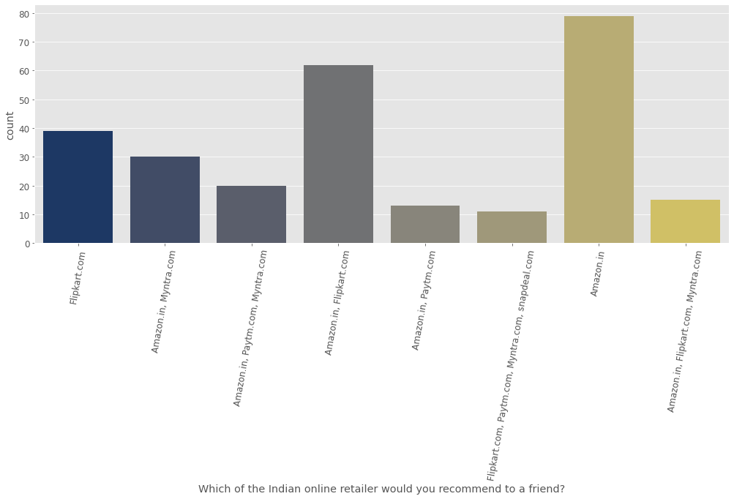
Conclusion
Which of the Indian online retailer would you recommend to a friend?
This graph concludes that most of the respondent recommend Amazon.in as Indian online retailer to a friend.

Slide 21
Thank You………

